Slide 1
2024年全国偏微分方程理论与应用研究学术会议
Intrinsic discretization of physics and mathematics:
Structure-preserving dual-field methods
A topic under development by a joint force of
Andrea Brugnoli, Artur Palha, Deepesh Toshniwal, Marc Gerritsma, Ramy Rashad, Stefano Stramigioli, Yi Zhang, et al.

Slide 2
2024年全国偏微分方程理论与应用研究学术会议
Intrinsic discretization of physics and mathematics:
Structure-preserving dual-field methods
Presenter: Yi Zhang
zhangyi_aero@hotmail.com
Discrete Geometries of Mathematics and Physics
School of Mathematics and Computing Science
Guilin University of Electronic Technology

Slide 3
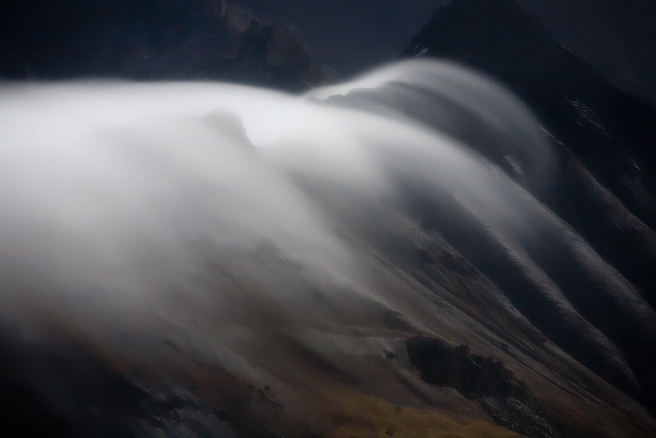
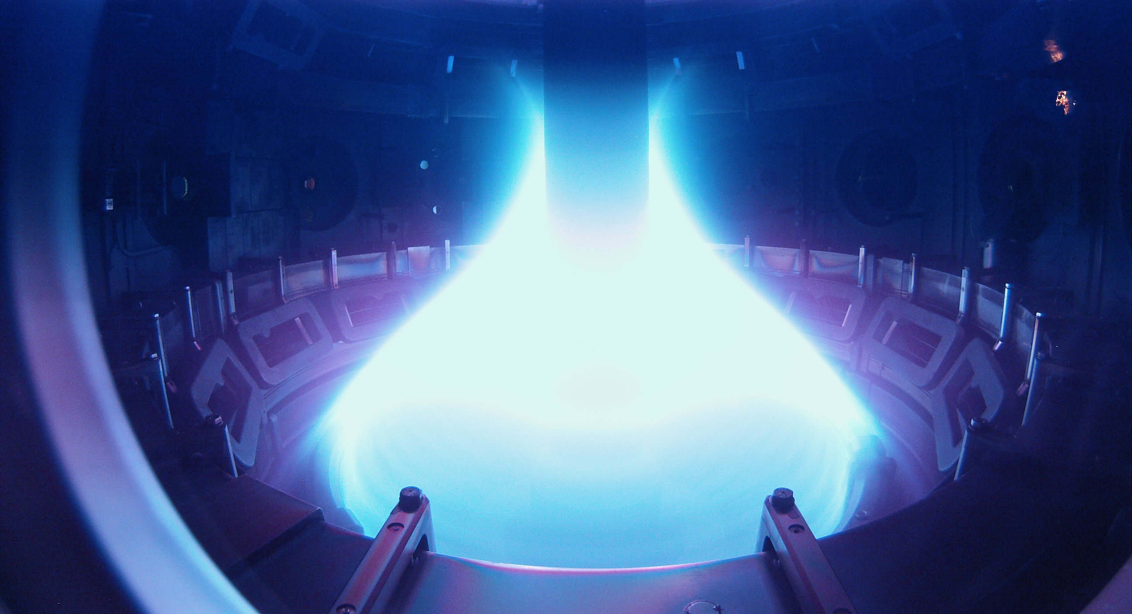
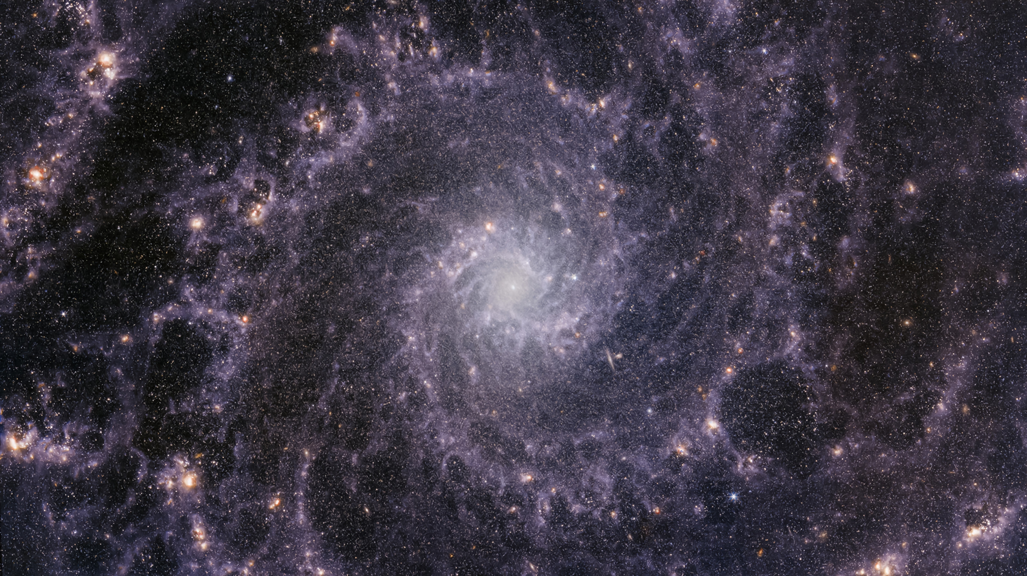
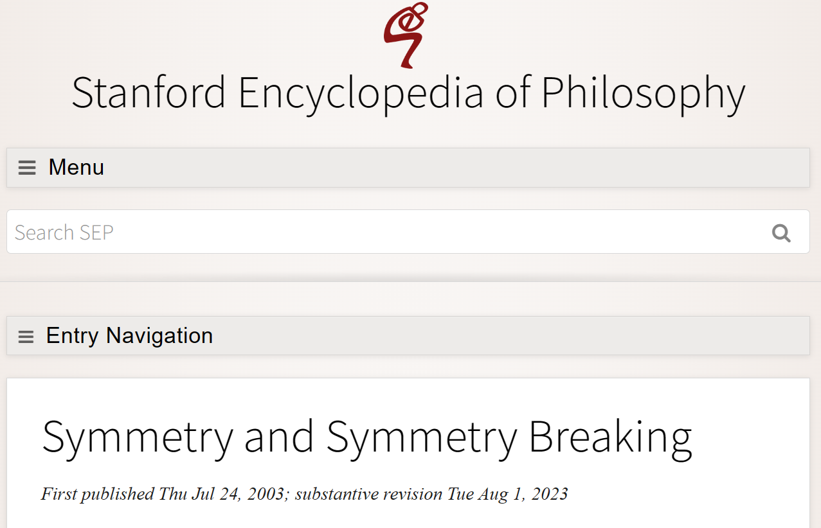
Intrinsic discretization of physics and mathematics:
Structure-preserving dual-field methods
Structures
Symmetry
Symmetries in time and space
Monotonicity
Conservation laws
- Momentum conservation (micro and macro)
- Energy conservation (macro)
- Mass conservation (macro)
- …

Slide 4
Intrinsic discretization of physics and mathematics:
Structure-preserving dual-field methods
Mathematics models:
Diffusive
Convective
Electronic
Magnetic
Radiative
Acoustic
……
Structures
Structures

Slide 5
Intrinsic discretization of physics and mathematics:
Structure-preserving dual-field methods
Mathematics models:
Diffusive
Convective
Electronic
Magnetic
Radiative
Acoustic
……
Structures
Structures

Slide 6
Intrinsic discretization of physics and mathematics:
Structure-preserving dual-field methods
Structures
Mathematics models:
- Mass conservation
- Kinetic energy $\left({\frac{1}{2}<u,u>}_{Ω}\right)$ conservation
- Momentum (linear and angular) conservation
- Enstrophy $\left({\frac{1}{2}<ω,ω>}_{Ω}\right)$ conservation
- Helicity $\left({<ω,u>}_{Ω}\right)$ conservation
- Vorticity $\left({<ω,1>}_{Ω}\right)$ conservation
……
In terms of discretization, they are not trivial.
“From infinite dimensions to finite dimensions. Approximations are made everywhere including in the structures.”

Slide 7
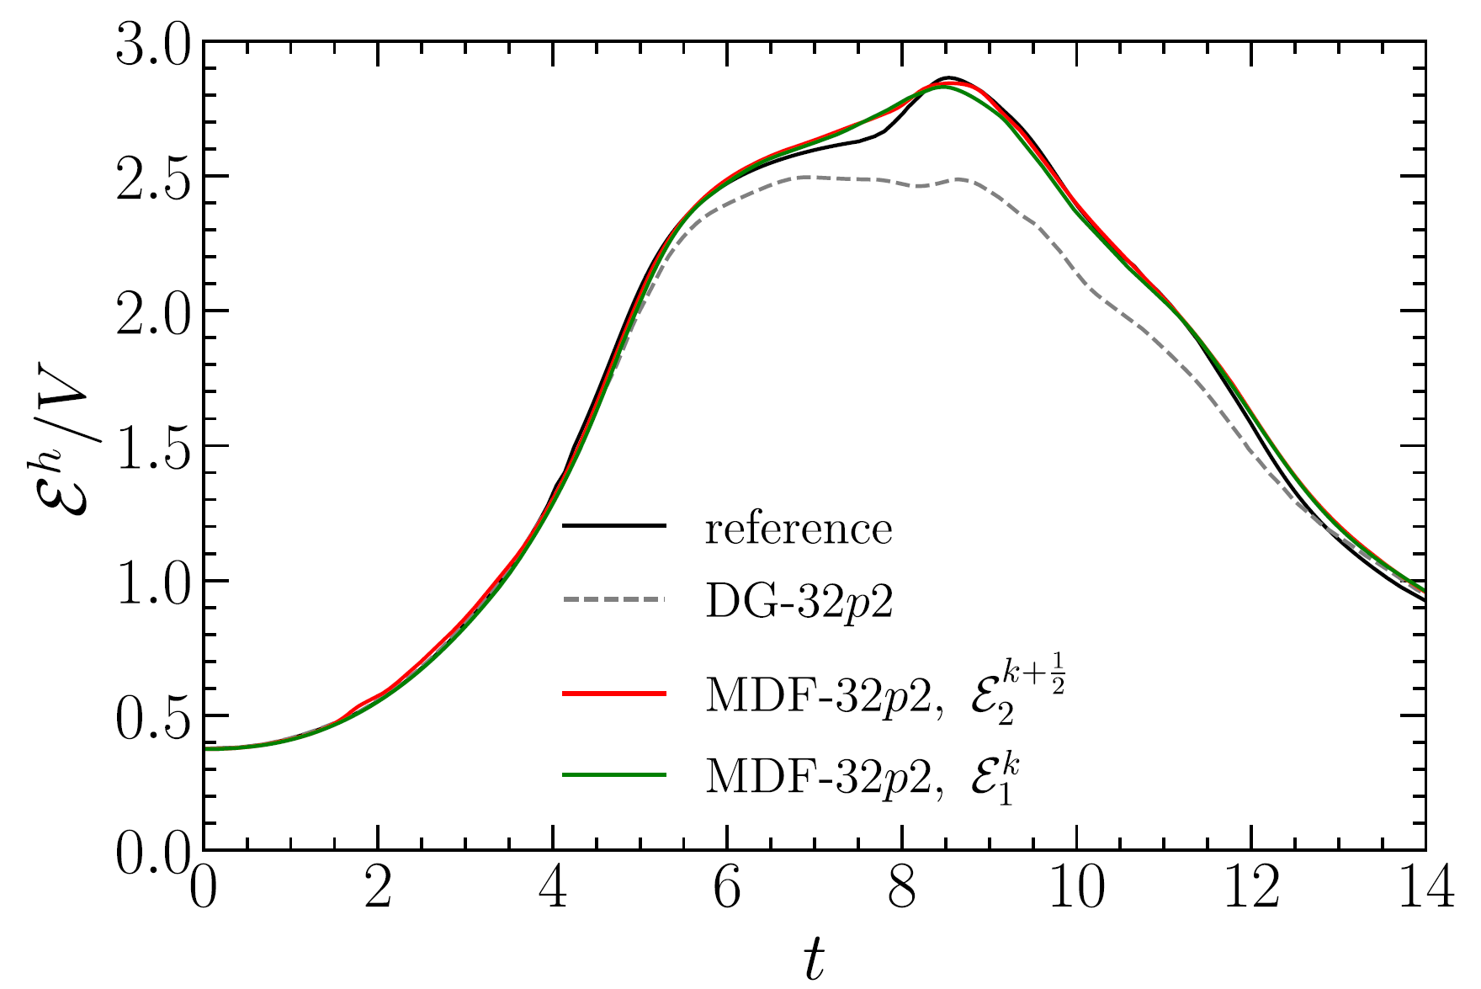
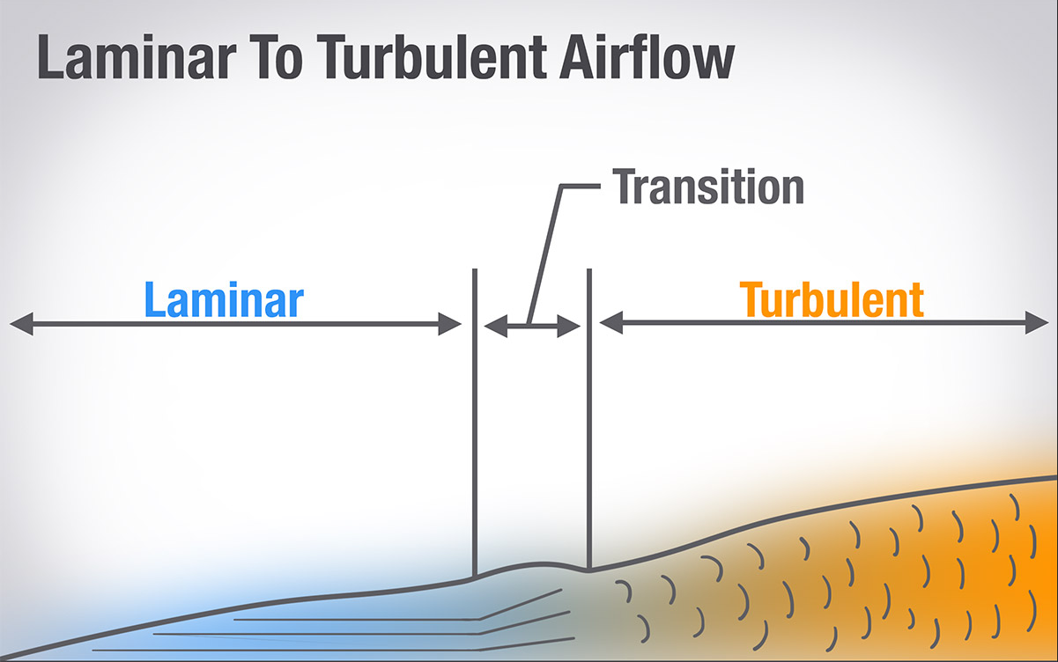
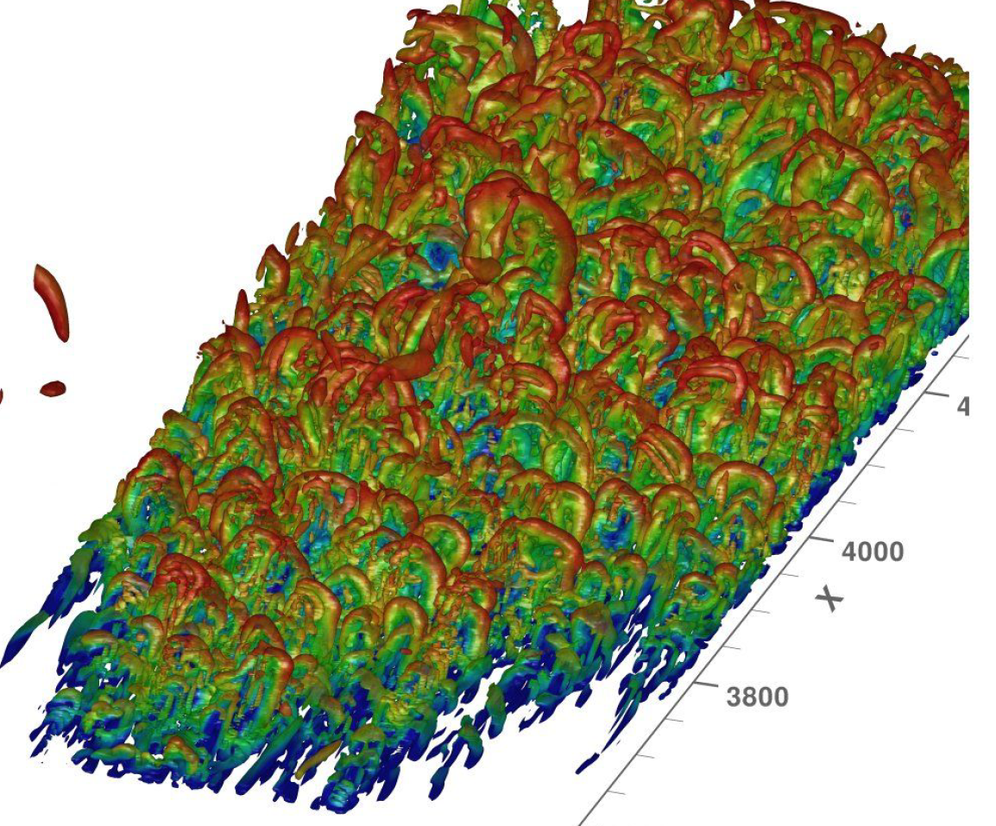
Intrinsic discretization of physics and mathematics:
Structure-preserving dual-field methods
“From infinite dimensions to finite dimensions. Approximations are made everywhere including in the structures.”
To avoid approximation in one or some structures: Structure-preserving methods
accuracy
stability
If a method conserves an energy, $K_{h}=\frac{1}{2}<u_{h}, u_{h}>_{Ω}$, then we know, automatically, the solution $u_{h}$ is bounded under an $L^{2}$-norm.

Slide 8
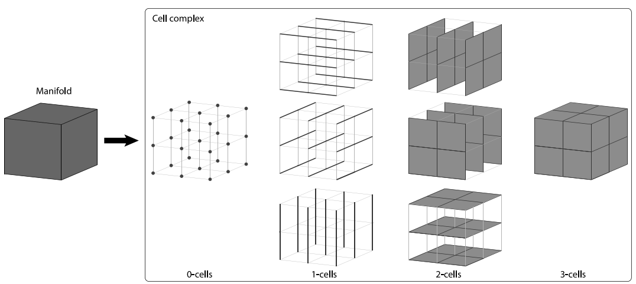
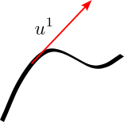
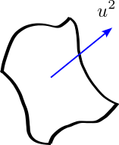
Intrinsic discretization of physics and mathematics:
Structure-preserving dual-field methods
Differential forms
What are differential forms ?
Intuitively:
“An integrand”
Technically:
“Totally anti-symmetric k-covariant tensor field”

Slide 9
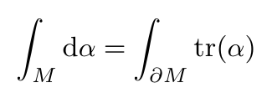
Intrinsic discretization of physics and mathematics:
Structure-preserving dual-field methods
Differential forms
vs. vector calculus

Slide 10
Intrinsic discretization of physics and mathematics:
Structure-preserving dual-field methods
Differential forms
Clear metric-dependent and metric-independent operations
Clear orientation dependency

Slide 11
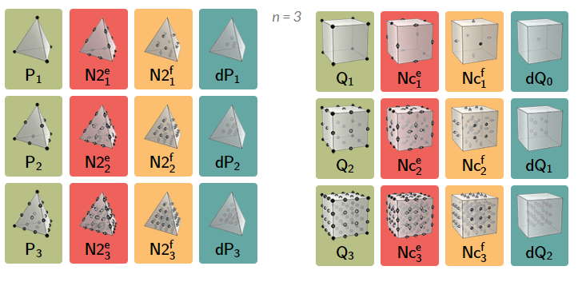
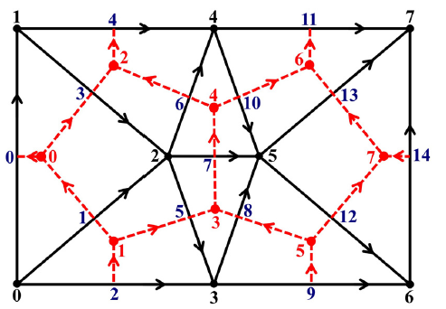
Intrinsic discretization of physics and mathematics:
Structure-preserving dual-field methods
Differential forms: classic applications
Finite Element Exterior Calculus (FEEC)
Discrete Exterior Calculus (DEC)

Slide 12
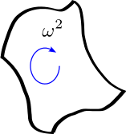
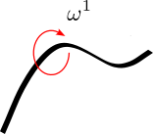
Intrinsic discretization of physics and mathematics:
Structure-preserving dual-field methods
Option 1
Example: Apply to incompressible Navier-Stokes equations:
Option 2

Slide 13
Intrinsic discretization of physics and mathematics:
Structure-preserving dual-field methods

Slide 14
Intrinsic discretization of physics and mathematics:
Structure-preserving dual-field methods

Slide 15
Intrinsic discretization of physics and mathematics:
Structure-preserving dual-field methods
To our knowledge, it is the first mass, energy and helicity conserving scheme.
[Zhang, Palha, Gerritsma, Rebholz. JCP, 2022]

Slide 16
Intrinsic discretization of physics and mathematics:
Structure-preserving dual-field methods
(videos deleted.)
1024
4096
16384
65536

Slide 17
Intrinsic discretization of physics and mathematics:
Structure-preserving dual-field methods
(videos deleted.)
Structure preserving ~64K
Standard Nonlinear ~64K

Slide 18
ThanKS
[1] Mohamed, Hirani, Samtaney, R. JCP, 2016
[2] Brugnoli, Rashad, Zhang, Stramigioli. (under review)
[3] Zhang, Palha, Gerritsma, Rebholz. JCP, 2022
[4] Rashad, Brugnoli, Califano, Luesink, Stramigioli. JNS, 2023
….
Many slides are directly taken from a presentation of Ramy Rashad to whom credits belong.

